Slide 1
Predicting Absenteeism
PineTex Impact

Slide 2
Absenteeism at PineTex
Enhance Response Protocol
Improved human resource management
Improved temp staff forecasting
Potential for insurance policy revisions

Slide 3
Exploratory Data Analysis
Preprocessing
No missingness
Identified & mitigated data entry errors
Discretized absenteeism for classification

Slide 4
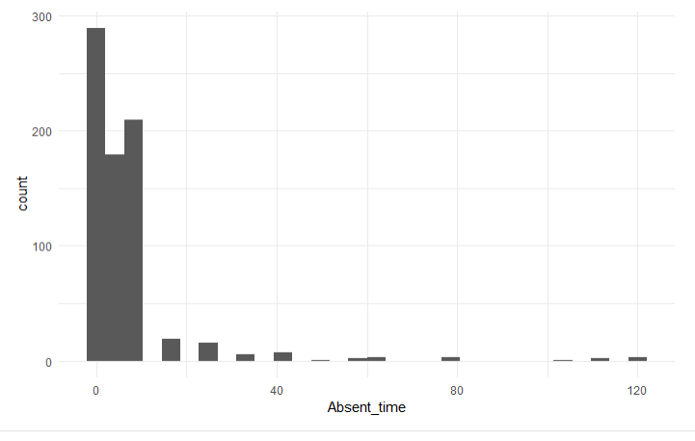
Exploratory Data Analysis

Slide 5
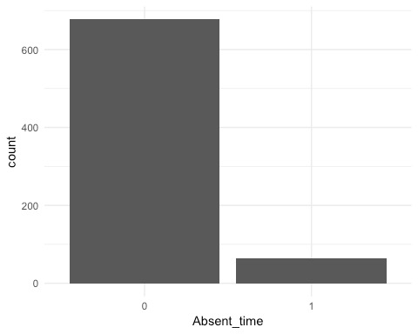
Exploratory Data Analysis

Slide 6
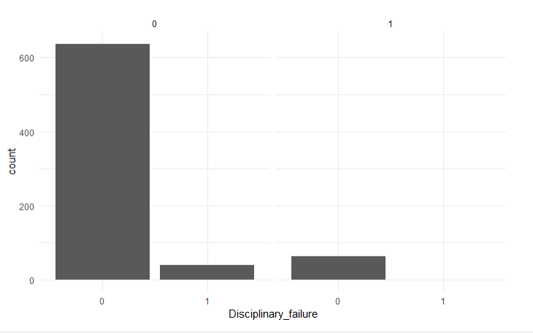
Exploratory Data Analysis
Short Absence (≤ 1 day)
Extended Absence (> 1 day)

Slide 7
Initial Models
K Nearest Neighbors (KNN)
General Linear Model (GLM)
Decision Tree
Random Forest
SVM

Slide 8
Model Metrics for Comparison
Sensitivity
F-Measure
Geometric Mean (G-Mean)
Model Error

Slide 9
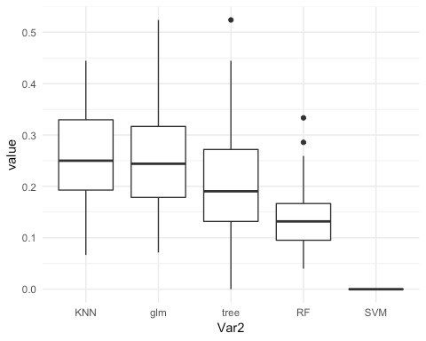
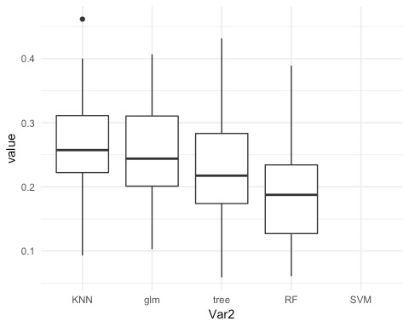
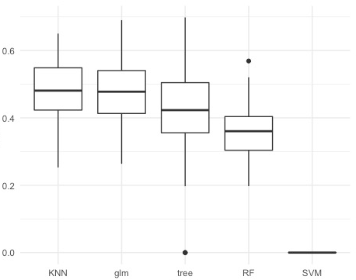
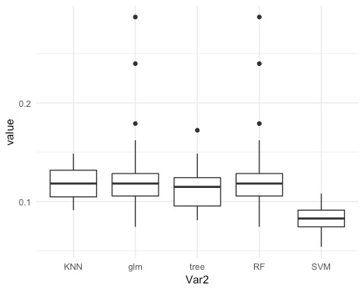
Sensitivity
F-Measure
23%
24%
G-Mean
Error
0.47
12%

Slide 10
Model Selection
Why KNN
Best metrics
Simplest model – Occam’s Razor

Slide 11
KNN Model Optimization
Objective
Improve prediction of minor class

Slide 12
KNN Model Optimization
Data
Cross Validation
Model Selection
Test Models
Result
Scale
SMOTE
K neighbors
Variables
Top 5 KNN models
New SMOTE data
Compare results for top 5 KNN models
Optimal KNN model

Slide 13
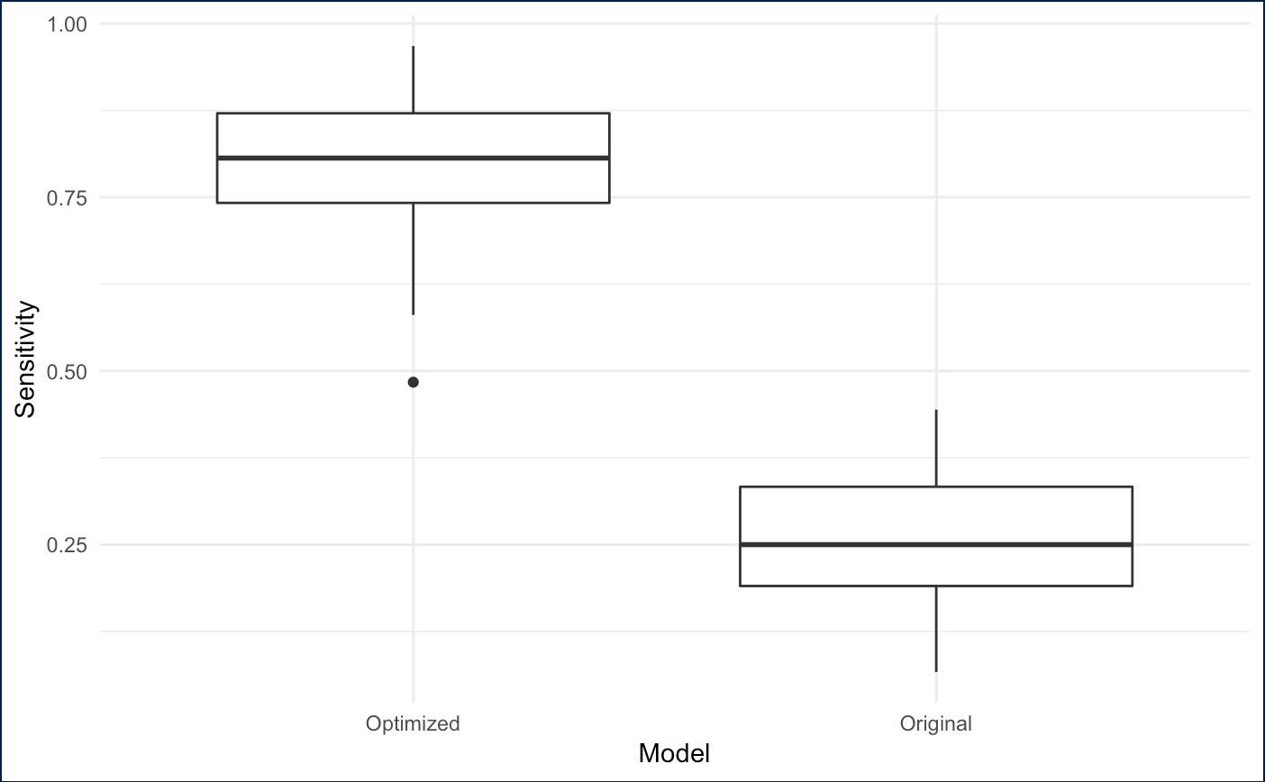
Model Comparison: Sensitivity

Slide 14
Model Comparison: Confusion Matrix
Optimized
Base
ACTUAL
ACTUAL
 | ≤ 1 Day | > 1 Day
≤ 1 Day | 264 | 4
> 1 Day | 73 | 27
 | ≤ 1 Day | > 1 Day
≤ 1 Day | 320 | 18
> 1 Day | 17 | 13
PREDICTED
PREDICTED

Slide 15



